Slide 1

NLP Project: Disaster Tweet Classification
Enhancing Emergency Response with AI
Project Goal: Develop a machine learning model to accurately classify tweets about real disasters.
Motivation: Social media's real-time information flow is critical during emergencies, yet challenging to analyze manually.
Impact: Improve disaster detection and response speed, contributing to public safety and management.
Photo by Firmbee.com on Unsplash

Slide 2
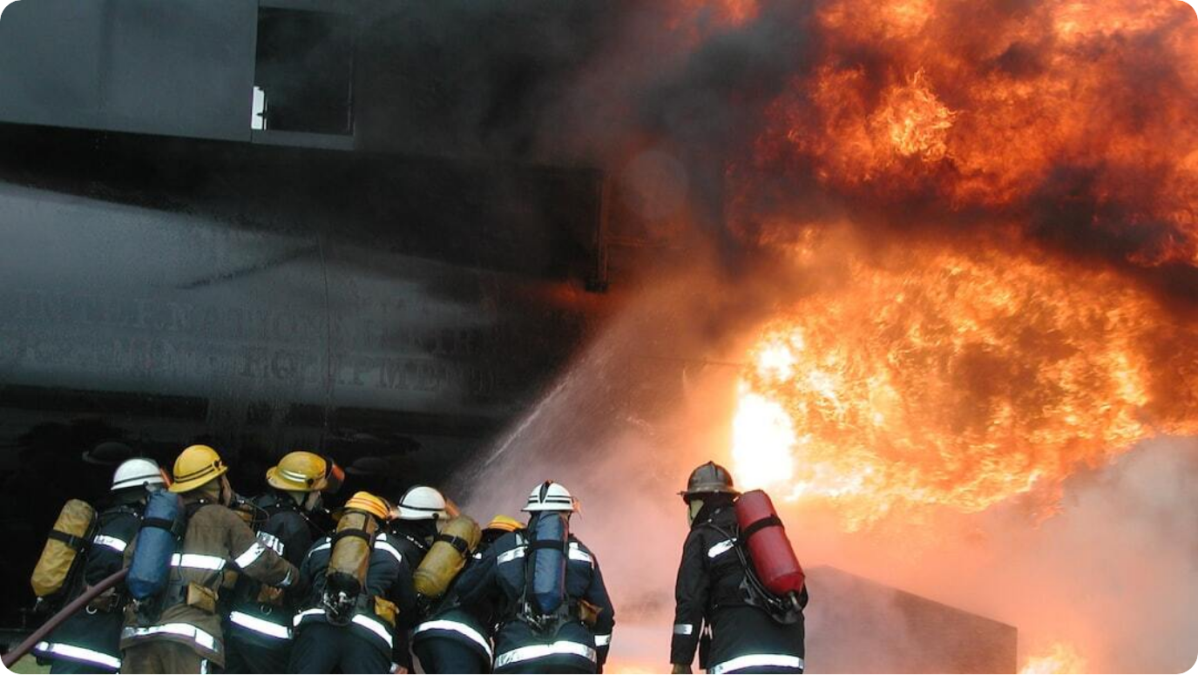
Background: Social Media and Disaster Management
The Need for Automated Tweet Classification
Real-Time Updates: Twitter offers immediate reporting during emergencies, often faster than traditional media.
Information Overload: High tweet volume during disasters makes manual monitoring impractical.
Detection Challenges: Tweets may use disaster-related language figuratively, complicating accurate detection.
Photo by Martin Powell on Unsplash

Slide 3

Challenge: Discerning Disaster Tweets
Complexities in Automated Classification
Ambiguity in Language: Keywords like 'fire' or 'flood' often used metaphorically, confusing classifiers.
Linguistic Diversity: Slang, abbreviations, and cultural variations add complexity to natural language understanding.
High Stakes: Misclassifications can delay disaster response or spread misinformation.
Photo by Merakist on Unsplash

Slide 4

Project Objectives
Goals for Effective Disaster Tweet Classification
Accurate Classification: Develop a model to distinguish between disaster-related and non-disaster tweets.
High Precision: Minimize false positives to ensure reliable and timely alerts.
Robustness: Handle linguistic variations like slang, abbreviations, and cultural nuances.
Scalability: Enable real-time processing of large tweet volumes.
Photo by engin akyurt on Unsplash

Slide 5
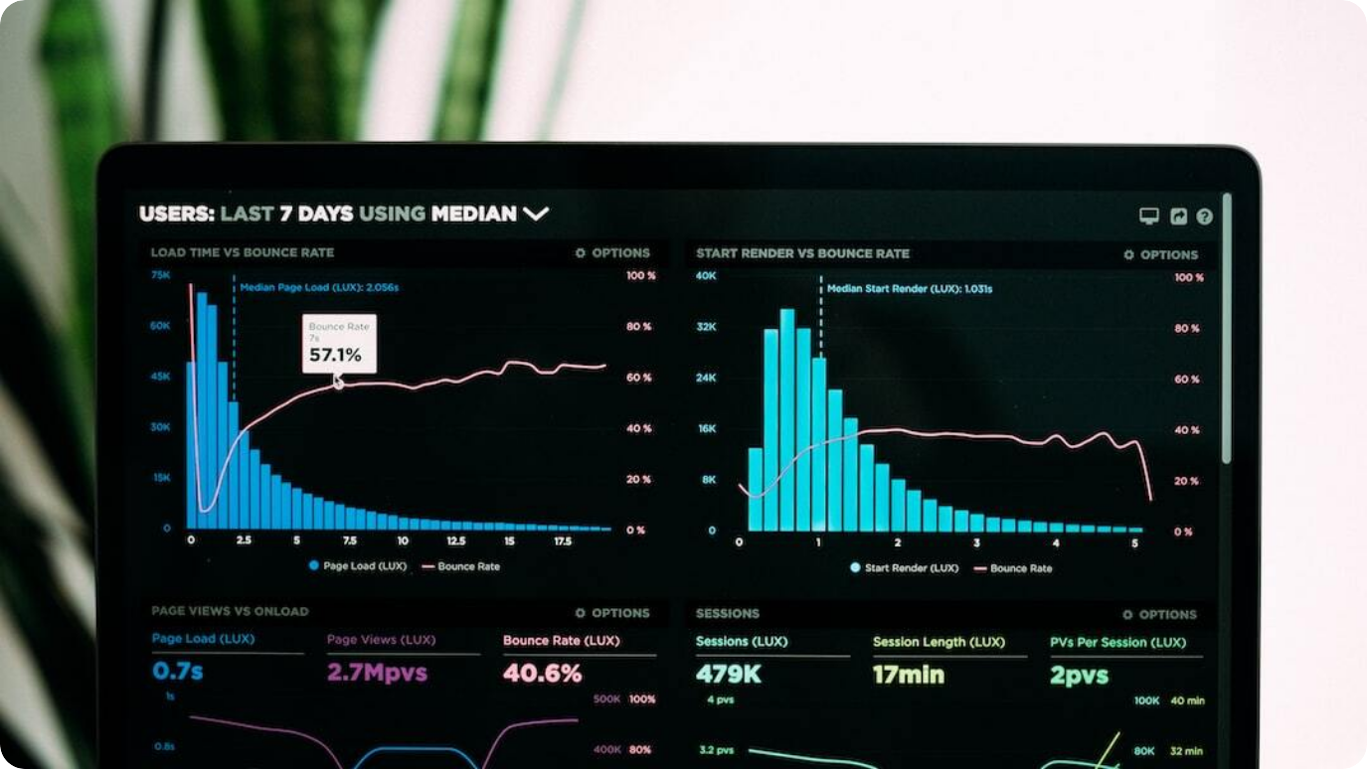
Data Exploration
Understanding the Disaster Tweets Dataset
Dataset Overview: Contains 11,000 labeled tweets related to disaster topics.
Class Distribution: Approximately 43% disaster-related, 57% non-disaster.
Common Keywords: Frequent terms include 'fire', 'earthquake', 'storm', and 'flood'.
Data Source: Kaggle’s Disaster Tweets dataset.
Photo by Luke Chesser on Unsplash

Slide 6




Data Preparation
Cleaning and Preprocessing Tweets for Modeling
Text Cleaning
Removed URLs, special characters, and punctuation to reduce noise.
Tokenization
Split tweets into individual word tokens for analysis.
Label Encoding
Converted disaster labels into binary format: 0 for non-disaster, 1 for disaster.
Data Splitting
Divided into 80% training and 20% testing datasets.
Notes:
Before modeling, rigorous data preparation was essential. We first cleaned the tweets — removing URLs, punctuation, and special characters — to reduce noise and improve model focus.
Tokenization followed: each tweet was split into its individual word components, preparing the text for analysis by machine learning algorithms.
For labeling, we converted the dataset into a binary format: assigning '0' for non-disaster tweets and '1' for disaster-related tweets. This format streamlined the classification process.
Finally, the data was split into training (80%) and testing (20%) sets to ensure unbiased evaluation of our model’s generalization capabilities.

Slide 7




Feature Engineering
Extracting Key Insights from Tweet Texts
TF-IDF Vectorization
Converted tweets into numerical form emphasizing important words. See TF-IDF setup below.
Named Entity Recognition
Extracted key locations and entities mentioned in disaster tweets. Example shown below.
Frequency Analysis
Identified top disaster and non-disaster words to understand tweet content.
Additional Features
Tweet length, hashtags, and user mentions considered for enhanced modeling.

Slide 8
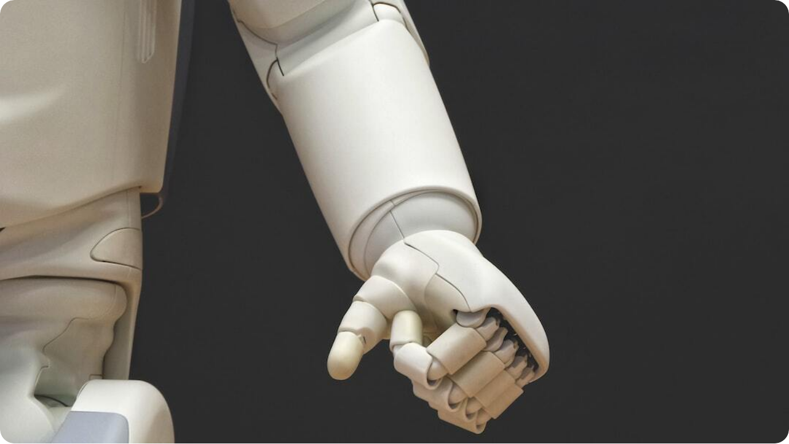
Model Selection and Training
Choosing and Optimizing Classifiers
Candidate Models: Logistic Regression, Random Forest, and Neural Networks tested.
Evaluation Technique: Cross-validation applied for robust model assessment.
Optimization: Grid search used to tune hyperparameters for best performance.
Final Model: Logistic Regression selected based on accuracy and interpretability.
Photo by Possessed Photography on Unsplash

Slide 9




Model Evaluation and Validation
Assessing Classifier Performance
Confusion Matrix
Shows true vs predicted labels with visual matrix (see below).
Key Metrics
Accuracy: 54.7%, Precision: 45.6%, Recall: 33.3%, F1-Score: 38.5%.
Cross-Validation
Achieved cross-validation accuracy of 78.3%.
Insights
Model needs improvement in detecting disaster tweets (higher false negatives).

Slide 10




Deployment and Web Interface
Real-Time Tweet Classification App
Model Serialization
Trained model saved as a pickle file for deployment.
Web Application
Flask-based app for real-time tweet classification.
User Interface
Simple text input with real-time disaster prediction output. Example shown below.
Deployment
Hosted on a cloud platform ensuring 24/7 accessibility.

Slide 11
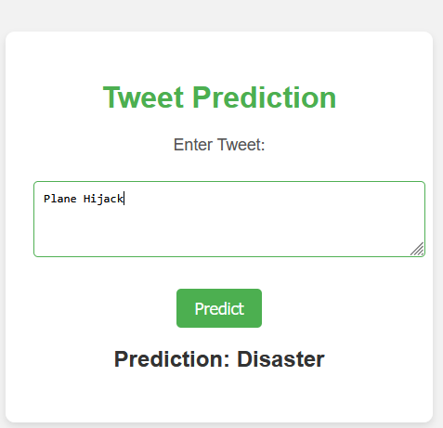
Web Interface
Real-Time Tweet Classification App

Slide 12



Conclusion
Impact and Future Opportunities
Enhanced Disaster Response
Faster and more reliable detection of real disaster events via social media.
Model Limitations
Need for improvement in disaster tweet detection accuracy and robustness.
Scalability Achieved
Web app allows real-time classification of incoming tweets at scale.
Future Directions
Incorporating deep learning and multilingual support for broader effectiveness.

Slide 13



Thank You!
Questions & Discussion
Project Recap
Disaster Tweet Classification using NLP and Machine Learning.
Deployment Ready
Scalable web application for real-time disaster detection.
Open for Questions
Excited to discuss insights, challenges, and future opportunities.

